Slide 1
Temporal Fusion Transformer: Predicting time series data
Benjamin Kettner

Slide 2








Thank you to our Sponsors!!!!
SQL SATURDAY
2022 Oregon & SW Washington

Slide 3
About me
Proud father
Metalhead
Mathematician
Data platform MVP
CTO at ML!PA Consulting GmbH (Berlin, GER)
@DataMonsterBen
benjamin.Kettner@ml-pa.com

Slide 4
Why is timeseries prediction hard?
Variety of inputs:
Timeseries that are known in the past
Static (time-invariant) data
Known future inputs
Unknown interaction of inputs with target
Unknown seasonality in target
Limited trust in models due to transparency of algorithms (“What caused this prediction?”)

Slide 5
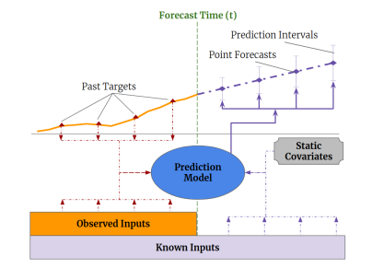
Input types
Image taken from https://arxiv.org/abs/1912.09363

Slide 6
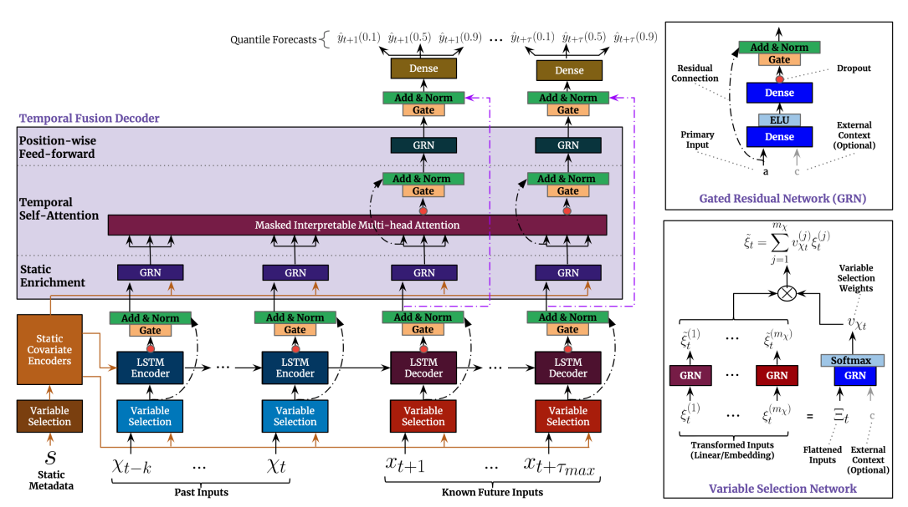
TFT Model architecture
Image taken from https://arxiv.org/abs/1912.09363

Slide 7
Components I
Variable selection networks:
Relevance and specific contribution of variables unknown
Removing unnecessary noisy inputs
Variable selection can improve performance

Slide 8
Components II
Gating:
Relationship between inputs and targets is unknown in advance
Extent of required non-linear processes is unknown
Flexibility to apply non-linear processes where needed
GRN in enrichment layer gives possibility to skip layers or suppress non-linear contribution

Slide 9
Components III
Static encoders
Integrate information from static metadata
Multi-Head Attention
Self-attention mechanism to learn long-term relationships across different time-steps (different seasonalities)
Enhance explainability

Slide 10
Components IV
Temporal fusion
Series of layers to learn temporal relationships
Local enhancement, relation of data with surrounding values
Static enhancement, static context without temporal dependence
Temporal self-attention to pick up long-range dependencies

Slide 11
Demos
To use jupyter in docker:
docker run -it --rm -p 10000:8888 -v ${PWD}:/home/jovyan/work jupyter/datascience-notebook

